Slide 1



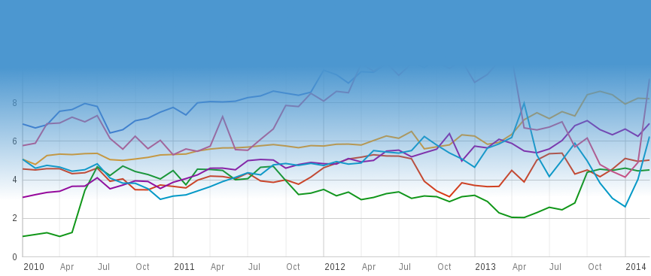
@NewAmerica
Measurement Lab
http://measurementlab.net
Independent, Public Interest
Network Performance Measurement

